Slide 1
Graph Algorithms
Jiexin Wang
School of Software Engineering
South China University of Technology

Slide 2
Minimum Spanning Tree
Section 9.5

Slide 3
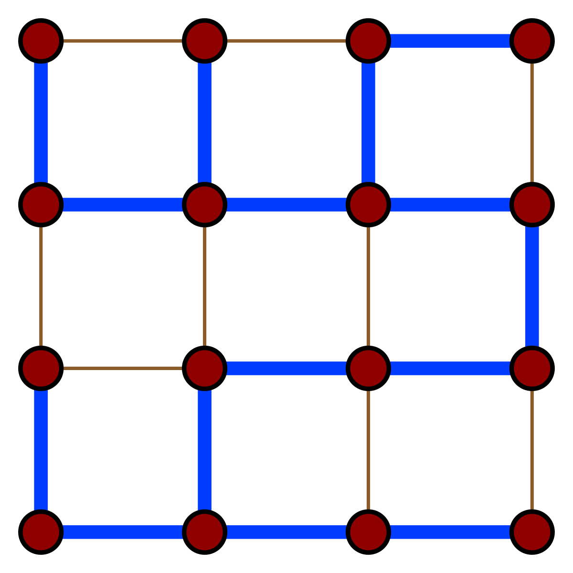
Recall Spanning Tree
Given (connected) graph G(V,E),
a spanning tree T(V’,E’):
  Spans the graph (V’ = V)
  Forms a tree (no cycle);
  E’ has |V| -1 edges

Slide 4
Minimum Spanning Tree
Edges are weighted: find minimum cost spanning tree
Applications
  Find cheapest way to wire your house
  Find minimum cost to send a message on the Internet
1
10
1
5
2
8
3
3
4
6
1
4
1
6
2
5
Has minimum total cost

Slide 5
Strategy for Minimum Spanning Tree
For any spanning tree T, inserting an edge e_{new} not in T creates a cycle
But
  Removing any edge e_{old} from the cycle gives back a spanning tree
  If e_{new} has a lower cost than e_{old} we have progressed!

Slide 6
Strategy
Strategy for construction:
  Add an edge of minimum cost that does not create a cycle (greedy algorithm)
  Repeat |V| -1 times
  Correct since if we could replace an edge with one of lower cost, the algorithm would have picked it up

Slide 7
Two Algorithms
Prim: (build tree incrementally)
  Pick lower cost edge connected to known (incomplete) spanning tree that does not create a cycle and expand to include it in the tree
Kruskal: (build forest that will finish as a tree)
  Pick lower cost edge not yet in a tree that does not create a cycle and expand to include it somewhere in the forest

Slide 8
Prim’s algorithm
Starting from empty V, choose a vertex at random and initialize
V = {1}
E’ ={}
1
10
1
5
2
8
3
3
4
6
1
4
1
6
2
5

Slide 9
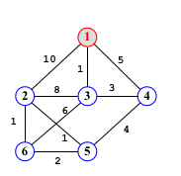
Prim’s algorithm
Choose the vertex u not in V such that edge weight from u to a vertex in V is minimal (greedy!)
V={1,3}
E’= {(1,3) }
1
10
1
5
2
8
3
3
4
6
1
4
1
6
2
5

Slide 10
Prim’s algorithm
Repeat until all vertices have been chosen
Choose the vertex u not in V such that edge weight from v to a vertex in V is minimal (greedy!)
V= {1,3,4}
E’= {(1,3),(3,4)}
1
10
1
5
2
8
3
2
3
4
6
1
4
1
6
5
6
2
5
V={1,3,4,5} E’={(1,3),(3,4),(4,5)}
……
V={1,3,4,5,2,6}
E’={(1,3),(3,4),(4,5),(5,2),(2,6)}

Slide 11
Prim’s algorithm
Repeat until all vertices have been chosen
V={1,3,4,5,2,6}
E’={(1,3),(3,4),(4,5),(5,2),(2,6)}
Final Cost: 1 + 3 + 4 + 1 + 1 = 10
1
10
1
5
2
8
3
2
3
4
6
1
4
1
6
5
6
2
5

Slide 12
Prim’s Algorithm Implementation
Assume adjacency list representation
(1) Initialize connection cost of each node to “infinite” and “unmark” them
(2) Choose one node, say v and set cost[v] = 0 and prev[v] =0
(3) While there are unmarked nodes
  Select the unmarked node u with minimum cost; mark it
  For each unmarked node w adjacent to u
    if cost(u,w) < cost(w) then cost(w) := cost (u,w)
    prev[w] = u
Looks a lot like Dijkstra’s algorithm!

Slide 13
Prim’s Algorithm Implementation
//Implementation of Prim’s algorithm for MST
void Prim(Graph* G, int* D, int s) {
int V[G->n()];
int i, w;
for (int i=0; i<G->n(); i++) // Initialize
D[i] = INFINITY; // cost
D[0] = 0;
for (i=0; i<G->n(); i++) {
int v = minVertex(G, D);
G->setMark(v, VISITED);
if (v != s)
AddEdgetoMST(V[v], v); //add edge to MST
if (D[v] == INFINITY) return; //unreachable vertices
for (w=G->first(v); w<G->n(); w=G->next(v,w))
if (D[w] > G->weight(v,w)) {
D[w] = G->weight(v,w); //Update cost
V[w] = v; // where it came from
}
}
}

Slide 14
Prim’s algorithm Analysis
Like Dijkstra’s algorithm
If the “Select the unmarked node u with minimum cost” is done with binary heap then O((n+m)logn)

Slide 15
Prim’s Algorithm
Prim’s algorithm is a greedy algorithm
  At each step in the for loop, we always select the least-cost edge that connects some marked vertex to some unmarked vertex.
Proof of Correctness
  Prim’s algorithm produces a minimum-cost spanning tree.
  Proof by contradiction

Slide 16
Proof of Prim’s Algorithm
Define an ordering on the vertices v₀, v₁, …, v_{n-1}
  according to the order in which they were added to the MST by the algorithm
Suppose edge e_{j} is the first edge (the lowest numbered) where the algorithm “went wrong” – differ from the “true” MST
  e_{j} = (v_{p}, v_{j}) where p<j
There must exist a path v_{j}->v_{w}->v_{u}->v_{p} (u<j and w>j) in the true MST that connect v_{p} and v_{j}
Edge e’ must be of lower cost than edge e_{j}
Contradict the “Prim’s algorithm would have selected the least-cost edge available”
’’correct’’ edge
e'
v_{w}
v_{u}
v_{j}
v_{p}
e_{j}
Prim’s edge

Slide 17
Kruskal’s Algorithm
Select edges in order of increasing cost
Accept an edge to expand tree or forest only if it does not cause a cycle
Implementation using adjacency list, priority queues and disjoint sets

Slide 18
Kruskal’s Algorithm
Initialize a forest of trees, each tree being a single node
Build a priority queue of edges with priority being lowest cost
Repeat until |V| -1 edges have been accepted {
Deletemin edge from priority queue
If it forms a cycle then discard it
else accept the edge – It will join 2 existing trees yielding a larger tree and reducing the forest by one tree
}
The accepted edges form the minimum spanning tree

Slide 19
Detecting Cycles
If the edge to be added (u,v) is such that vertices u and v belong to the same tree, then by adding (u,v) you would form a cycle
  Therefore to check, Find(u) and Find(v). If they are the same discard (u,v)
  If they are different Union(Find(u),Find(v))

Slide 20
Properties of trees in K’s algorithm
Vertices in different trees are disjoint
  True at initialization and Union won’t modify the fact for remaining trees
Trees form equivalent classes under the relation “is connected to”
  u connected to u (reflexivity)
  u connected to v implies v connected to u (symmetry)
  u connected to v and v connected to w implies a path from u to w so u connected to w (transitivity)

Slide 21
Kruskal’s Algorithm
vector<Edge> kruskal( vector<Edge> edges, int numVertices )
{
DisjSets ds{ numVertices };
priority_queue pq{ edges };
vector<Edge> mst;
while( mst.size( ) != numVertices - 1 ){
Edge e = pq.pop( ); // Edge e = (u, v)
SetType uset = ds.find( e.getu( ) );
SetType vset = ds.find( e.getv( ) );
if( uset != vset ){
// Accept the edge
mst.push_back( e );
ds.union( uset, vset );
}
}
return mst;
}

Slide 22
Example
1
10
1
5
2
8
3
3
4
6
1
4
1
6
2
5

Slide 23
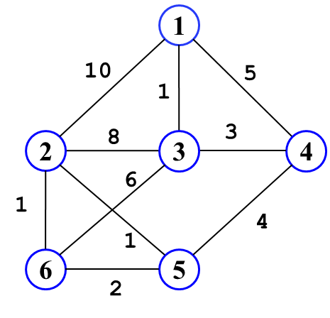
Initialization
Initially, Forest of 6 trees
F= {{1},{2},{3},{4},{5},{6}}
Edges in a heap (not shown)
1
2
4
6
5

Slide 24
Step 1
Select edge with lowest cost (1,3)
Find(1) = 1, Find (3) = 3
Union(1,3)
F= {{1,3},{2}, {4},{5},{6}}
1 edge accepted
1
1
2
3
4
6
5

Slide 25
Step 2
Select edge with lowest cost (2,5)
Find(2) = 2, Find (5) = 5
Union(2,5)
F= {{1,3},{2,5}, {4},{6}}
2 edge accepted
1
1
2
3
4
1
6
5

Slide 26
Step 3
Select edge with lowest cost (2,6)
Find(2) = 2, Find (6) = 6
Union(2,6)
F= {{1,3},{2,5,6}, {4}}
3 edge accepted
1
1
2
3
4
1
1
6
5
Notes:
构成循环

Slide 27
Step 4
Select edge with lowest cost (5,6)
Find(5) = 2, Find (6) = 2
Do nothing
F= {{1,3},{2,5,6}, {4}}
3 edge accepted
1
1
2
3
4
1
1
6
5

Slide 28
Step 5
Select edge with lowest cost (3,4)
Find(3) = 1, Find (4) = 4
Union(1,4)
F= {{1,3,4},{2,5,6}}
4 edge accepted
1
1
2
3
3
4
1
1
6
5

Slide 29
Step 6
Select edge with lowest cost (4,5)
Find(4) = 1, Find (5) = 2
Union(1,2)
F= {{1,3,4,2,5,6}}
5 edge accepted: end
Total cost = 10
1
1
2
3
3
4
1
4
1
6
5
Although there is a unique spanning tree in this example, this is not generally the case

Slide 30
Kruskal’s Algorithm Analysis
Initialize forest O(n)
Initialize heap O(m), m = |E|
Loop performed m times
  In the loop one Deletemin O(logm)
  Two Find, each O(logn)
  One Union (at most) O(1)
Worse case time complexity： O(mlogm) = O(mlogn)

Slide 31
Time Complexity Summary
Recall that m = |E| = O(|V|²) = O(n² )
Prim’s runs in O((n+m) log n)
Kruskal’s runs in O(mlogm) = O(mlogn)
In practice, Kruskal has a tendency to run faster since graphs might not be dense and not all edges need to be looked at in the Deletemin operations

Slide 32
Homework 7-3
Textbook Exercises 9.15

